Slide 1
Power Query
Varsha mhetre

Slide 2
What is Power Query
Power Query is a data transformation and data preparation engine. Power Query comes with a graphical interface for getting data from sources and a Power Query Editor for applying transformations.
With Power Query (known as Get & Transform in Excel), you can import or connect to external data, and then shape that data, for example remove a column, change a data type, or merge tables, in ways that meet your needs.

Slide 3
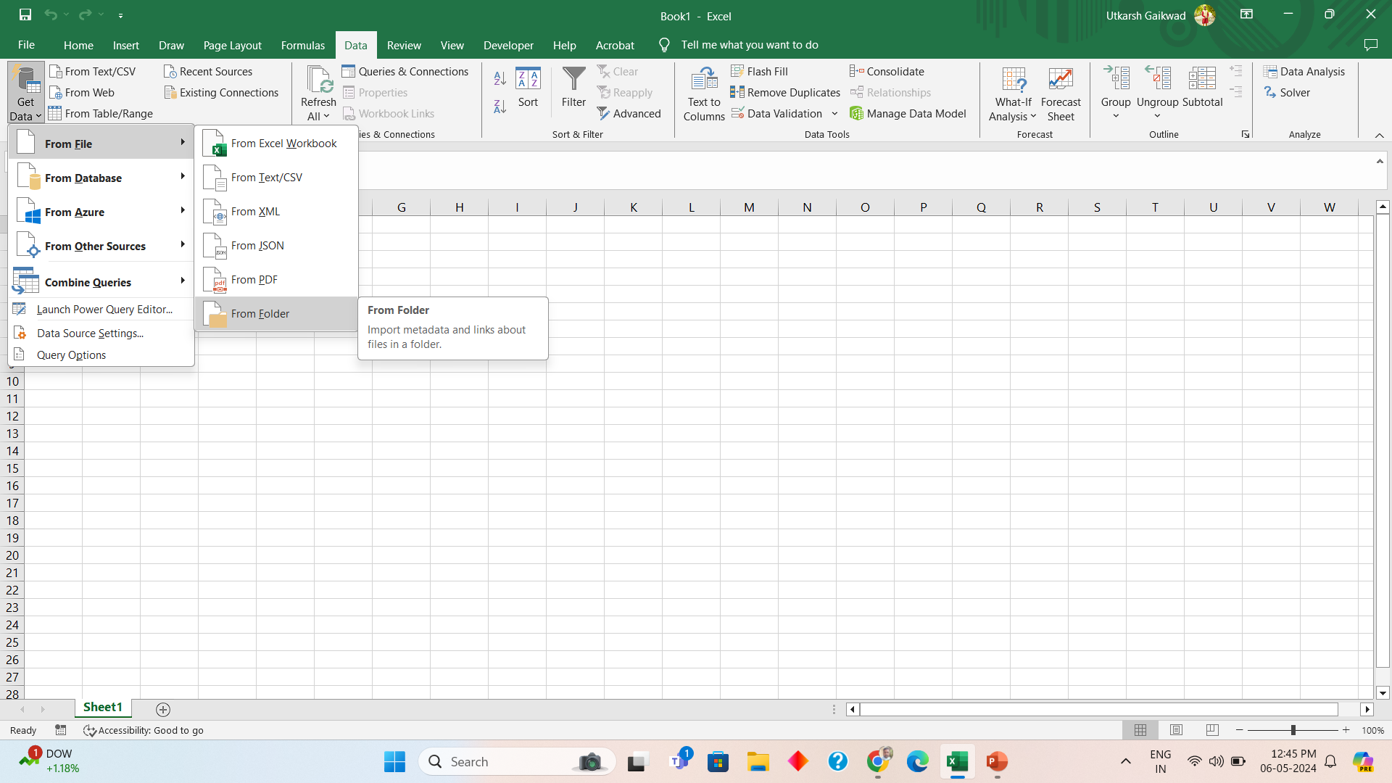
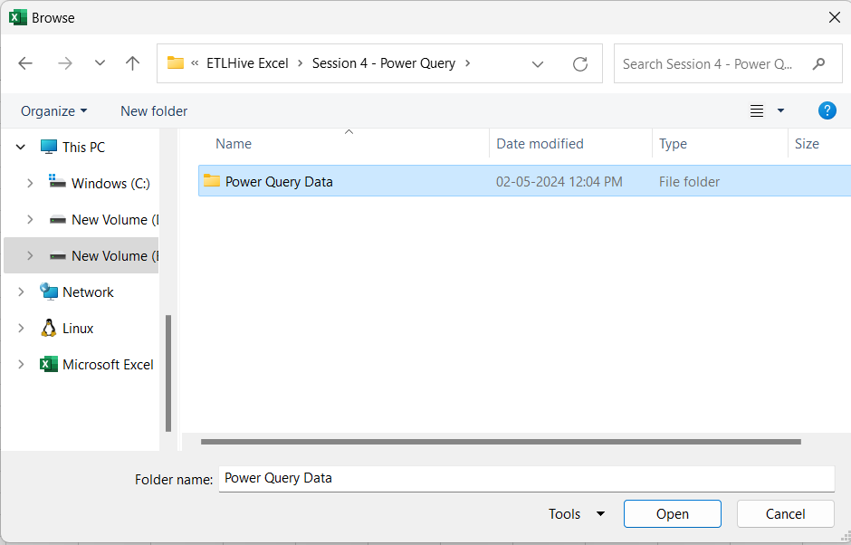
How to Extract data from folder into Power Query
Step 1 : Data
Step 2 :Get Data
Step 3 :From File
Step 4 :From Folder
Step 5: Select folder
Step 6: Open

Slide 4
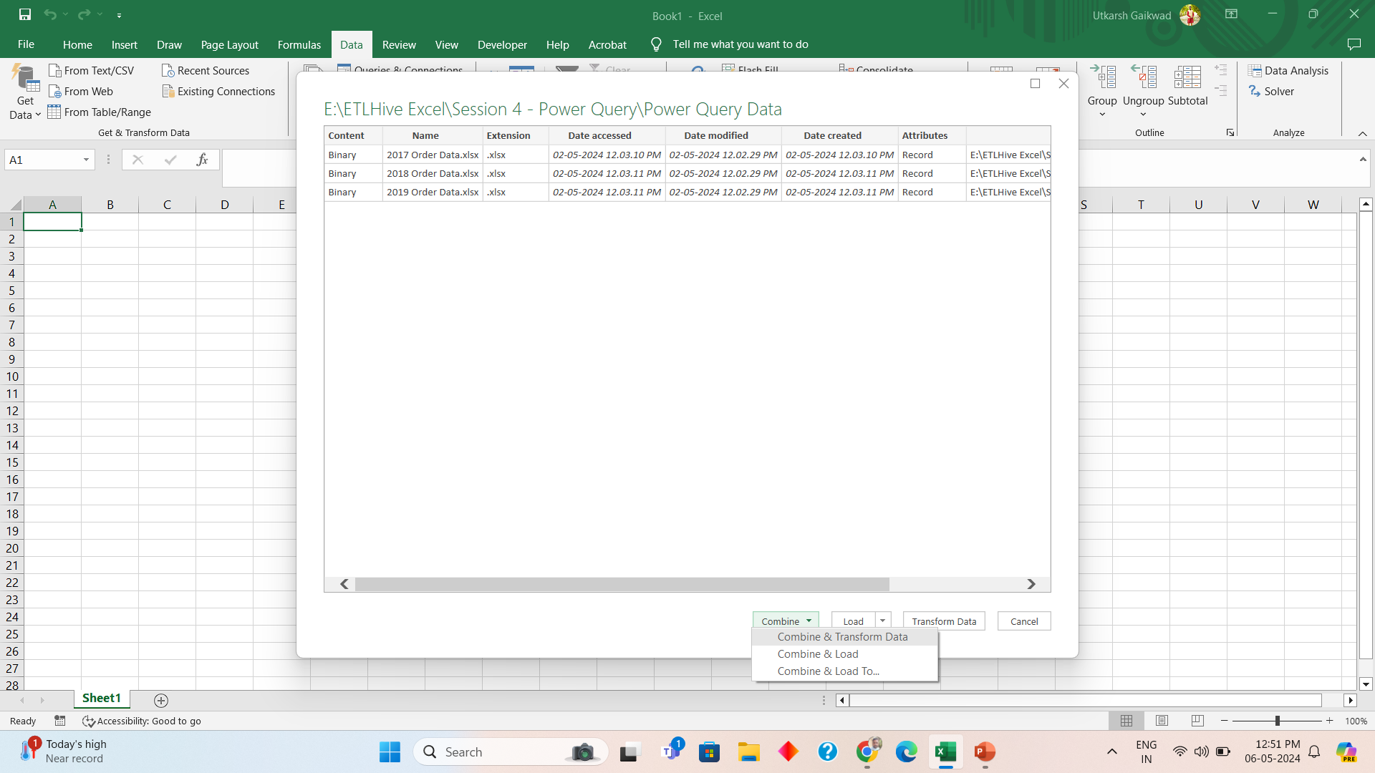
How to combine and transform data
Combine > Combine and Transform

Slide 5
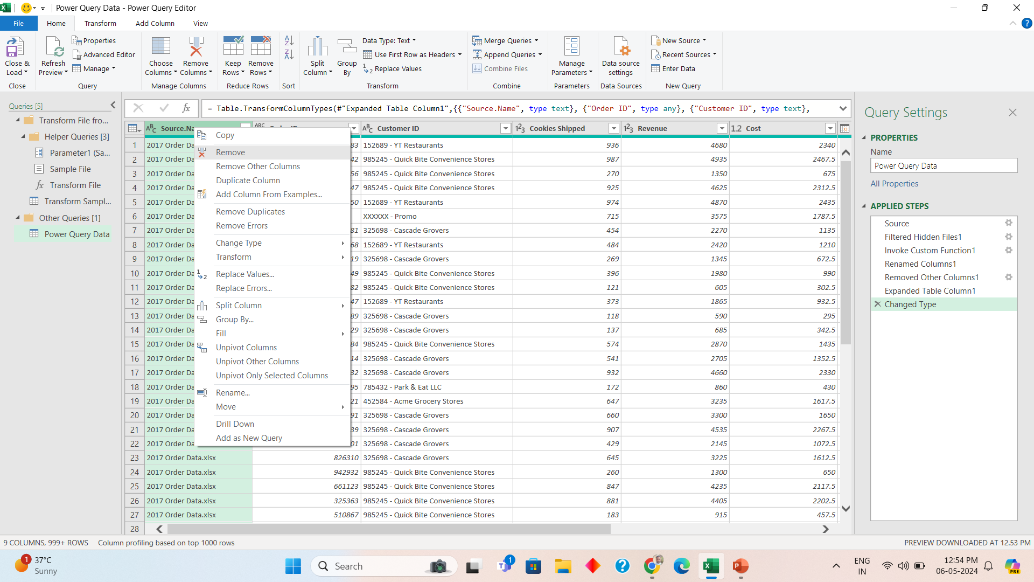
Deleting a column
Step 1: right click on column
You want to remove
Step 2: Click Remove

Slide 6
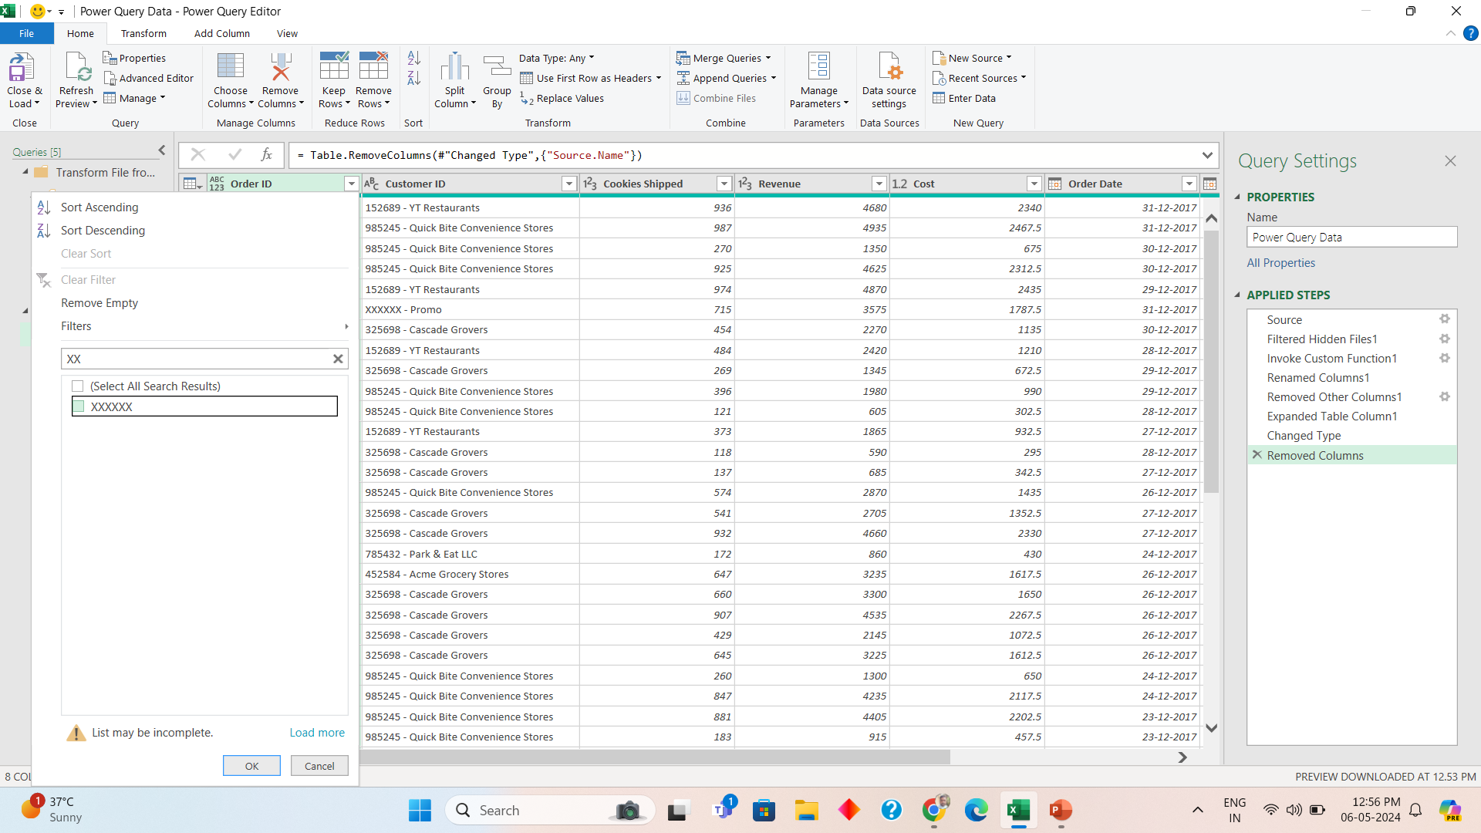
Filtering out data which is not required
Step 1: Click on Down arrow on Column where filter needs to be applied
Step 2: Type Data to
be filtered
Step 3: Untick the checkbox
Step 4: Click on OK

Slide 7
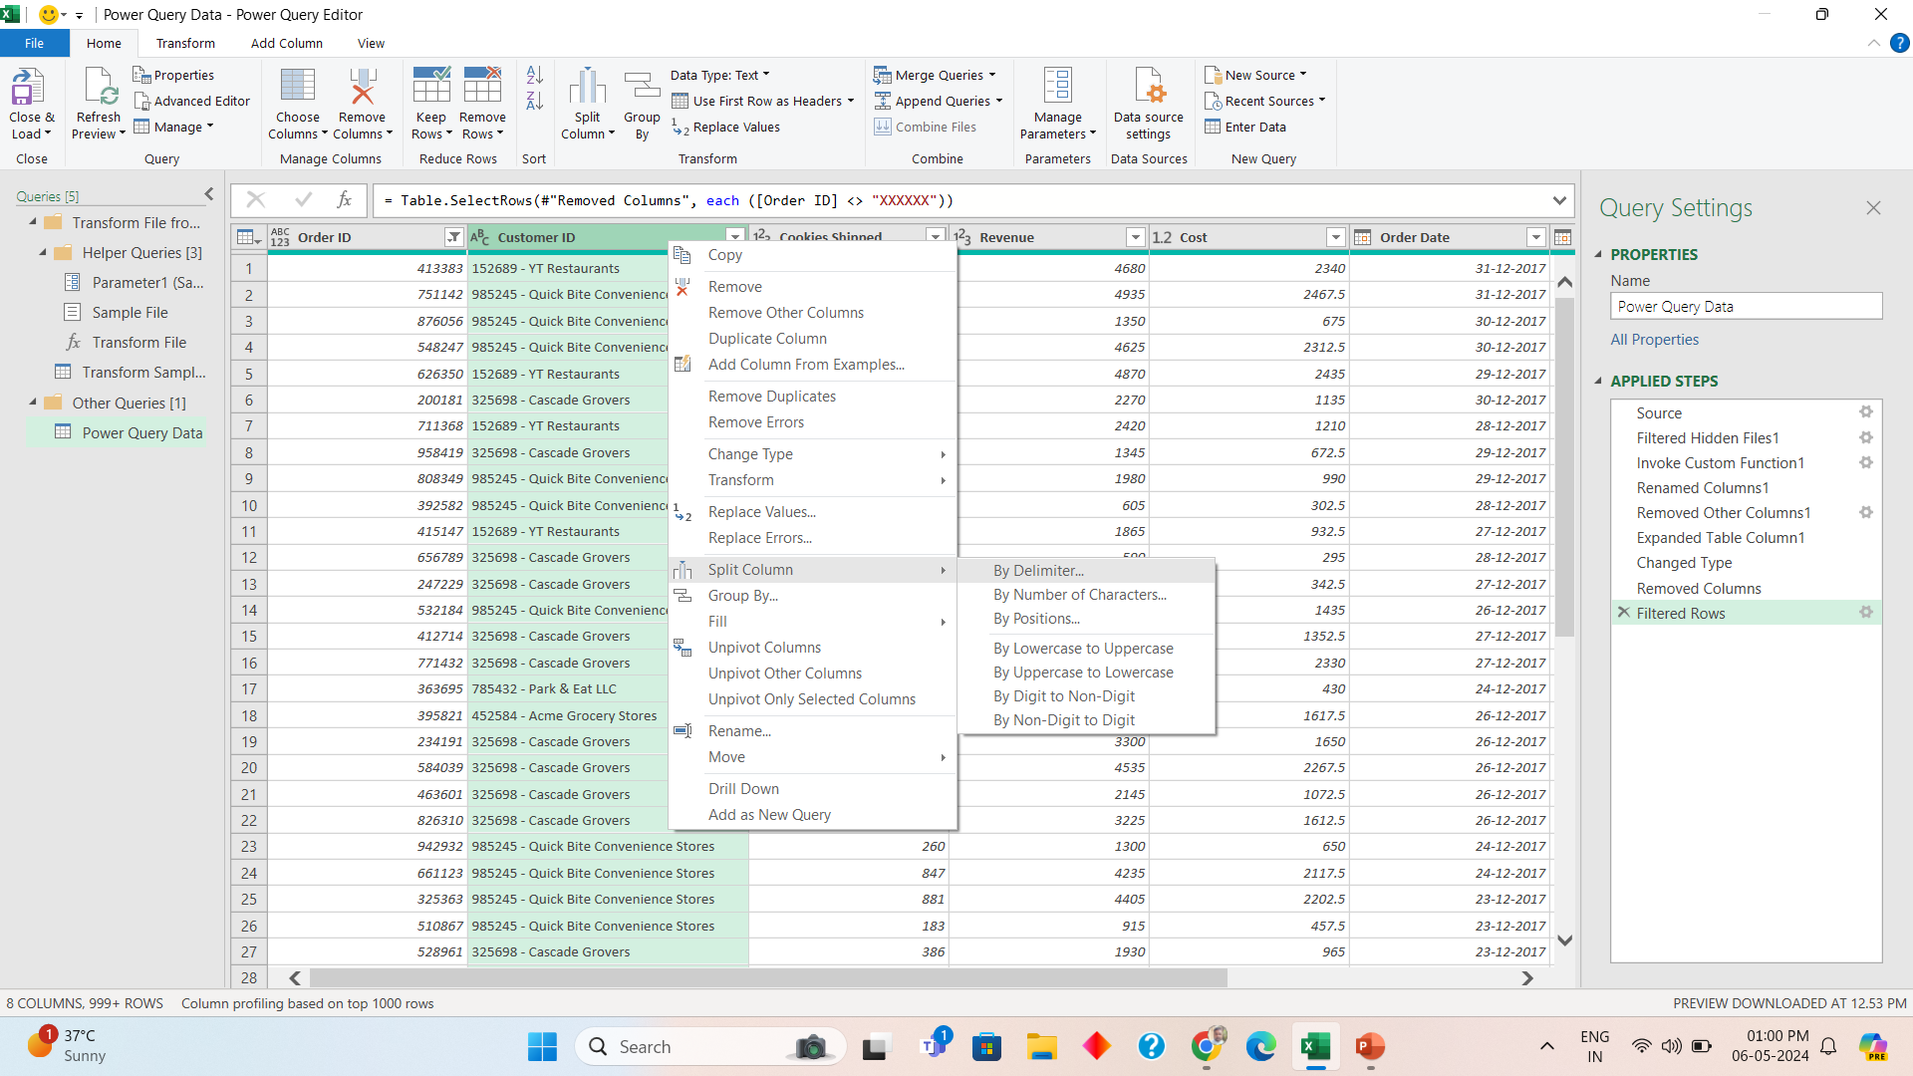
Create separate columns for Customer ID and Name
Step 1: Right Click Customer ID
Step 2: Split Column
Step 3: By Delimiter

Slide 8
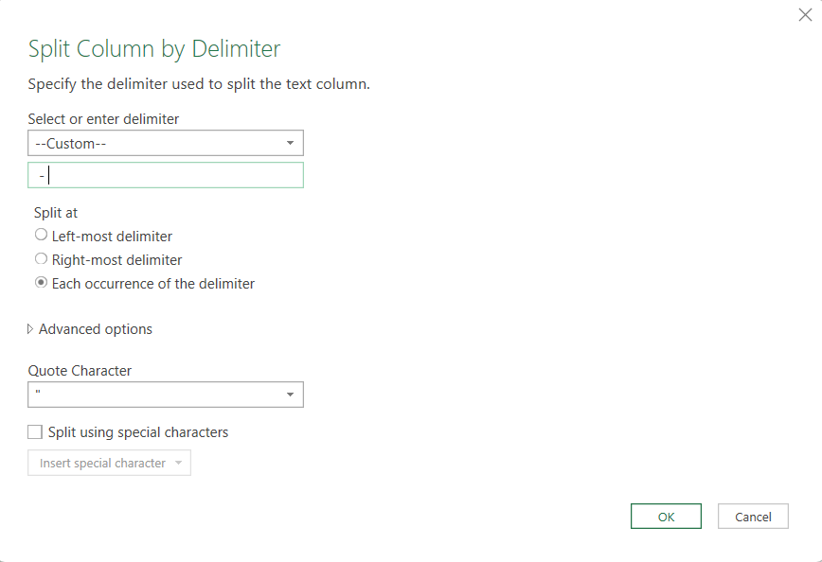
Create separate columns for Customer ID and Name Contd
Type – “ – “ ,”Space-Space” Make sure to add proper spaces

Slide 9
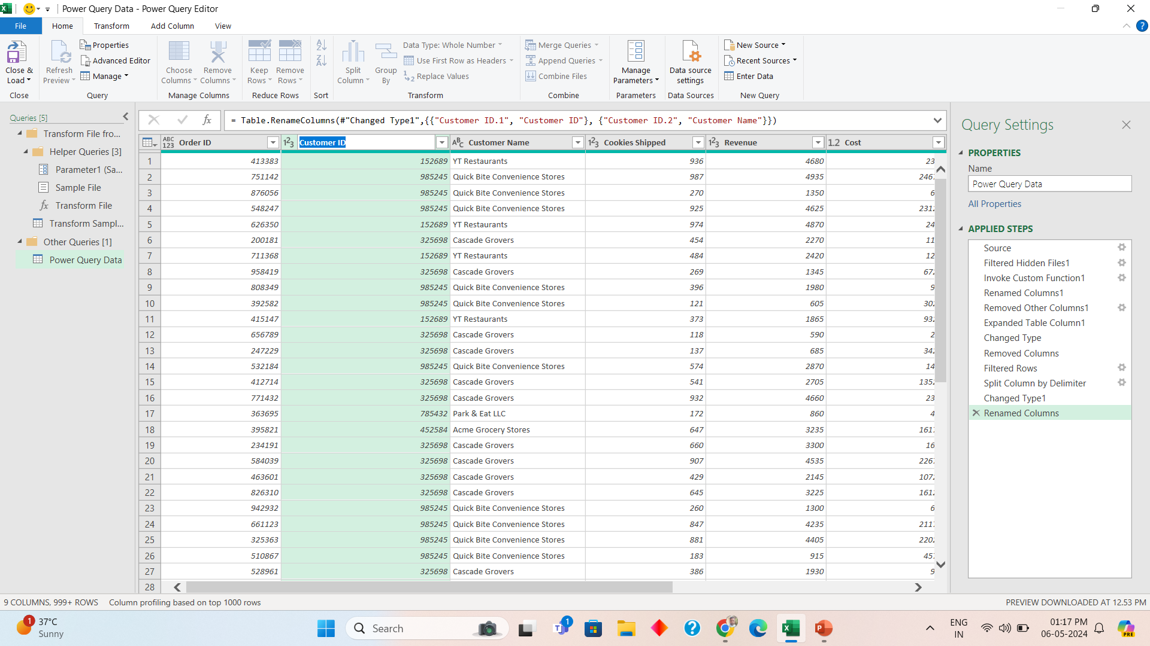
Double click to change column name
Double click column name to change column name

Slide 10
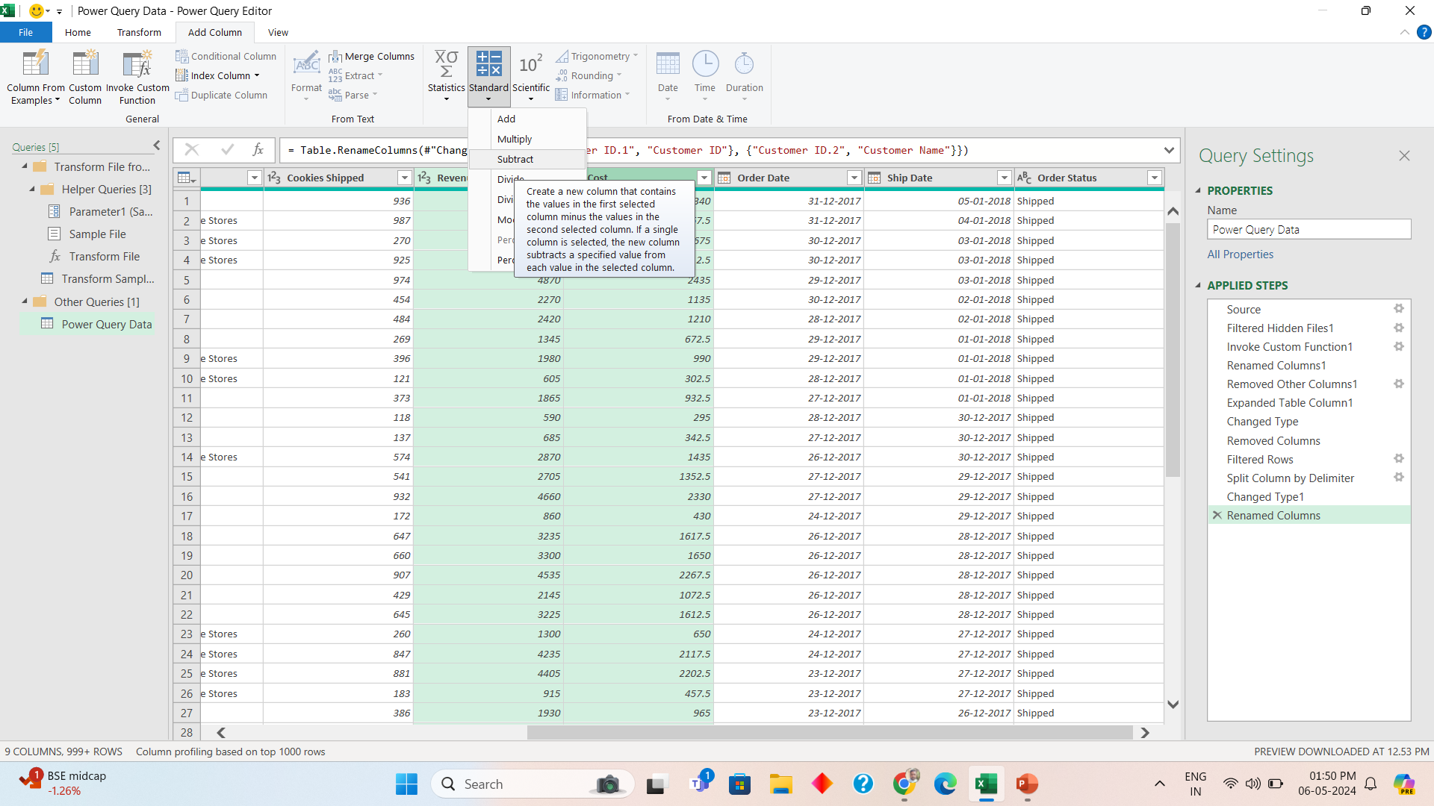
Want to add profit column Profit = Revenue - Cost
Step 1 :
Select Revenue first
Then cost

Slide 11
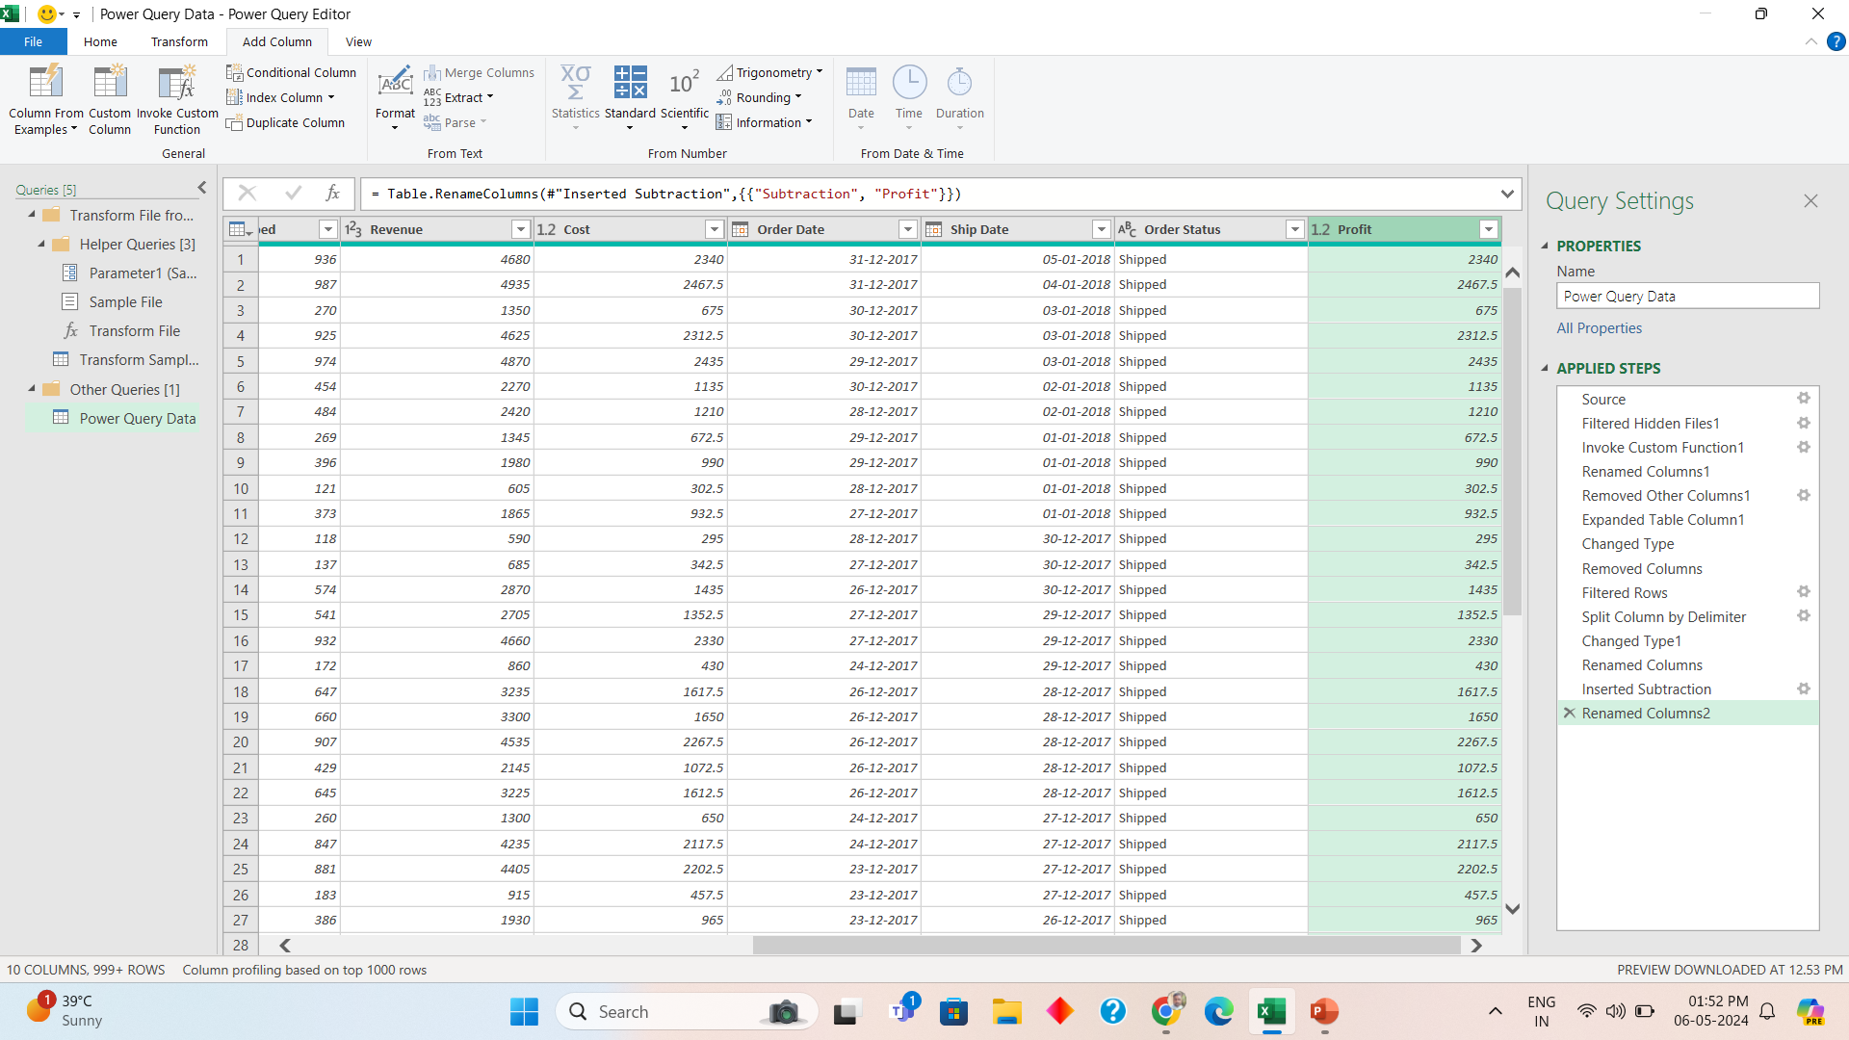
Shift columns by dragging

Slide 12
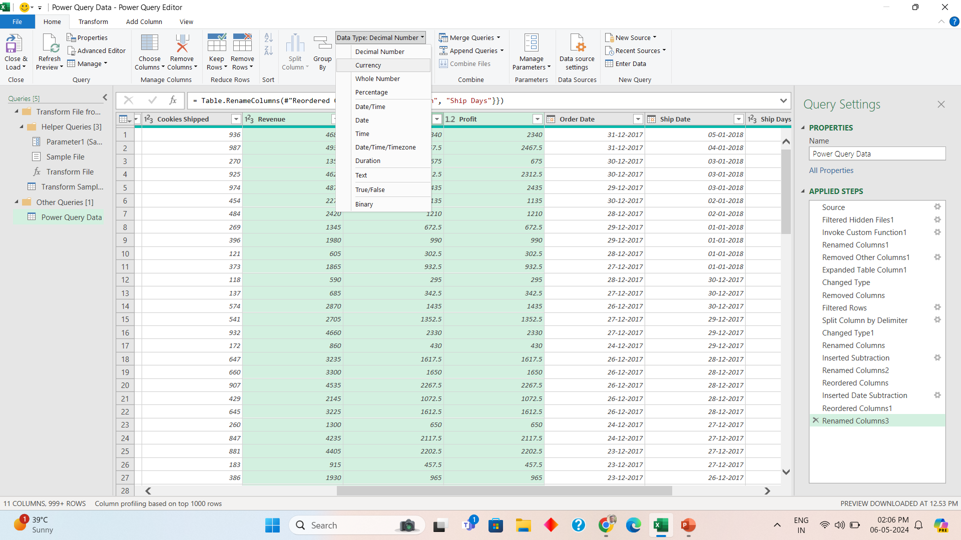
Change datatype to currency

Slide 13
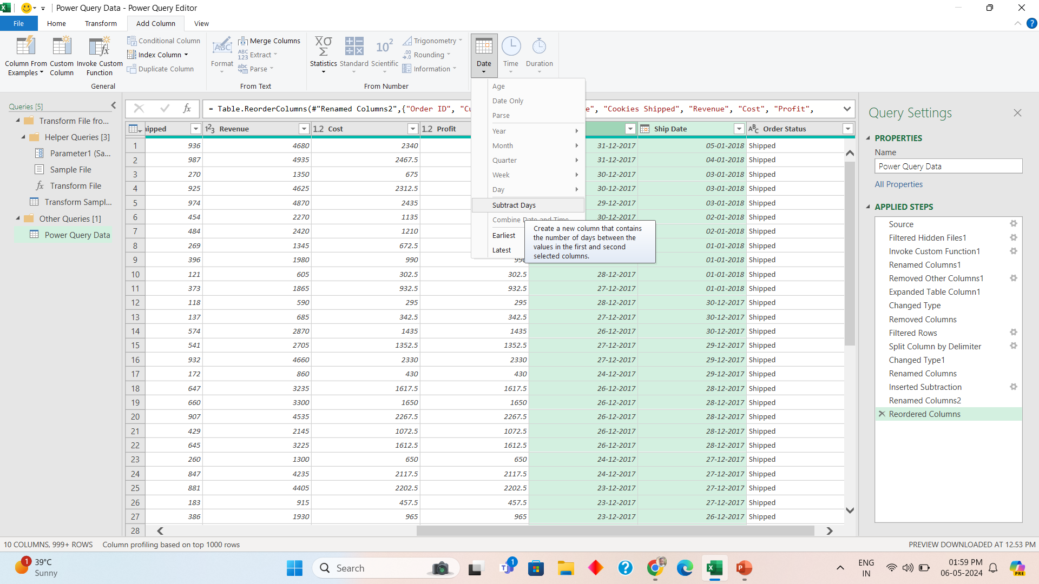
Create shipping days column

Slide 14
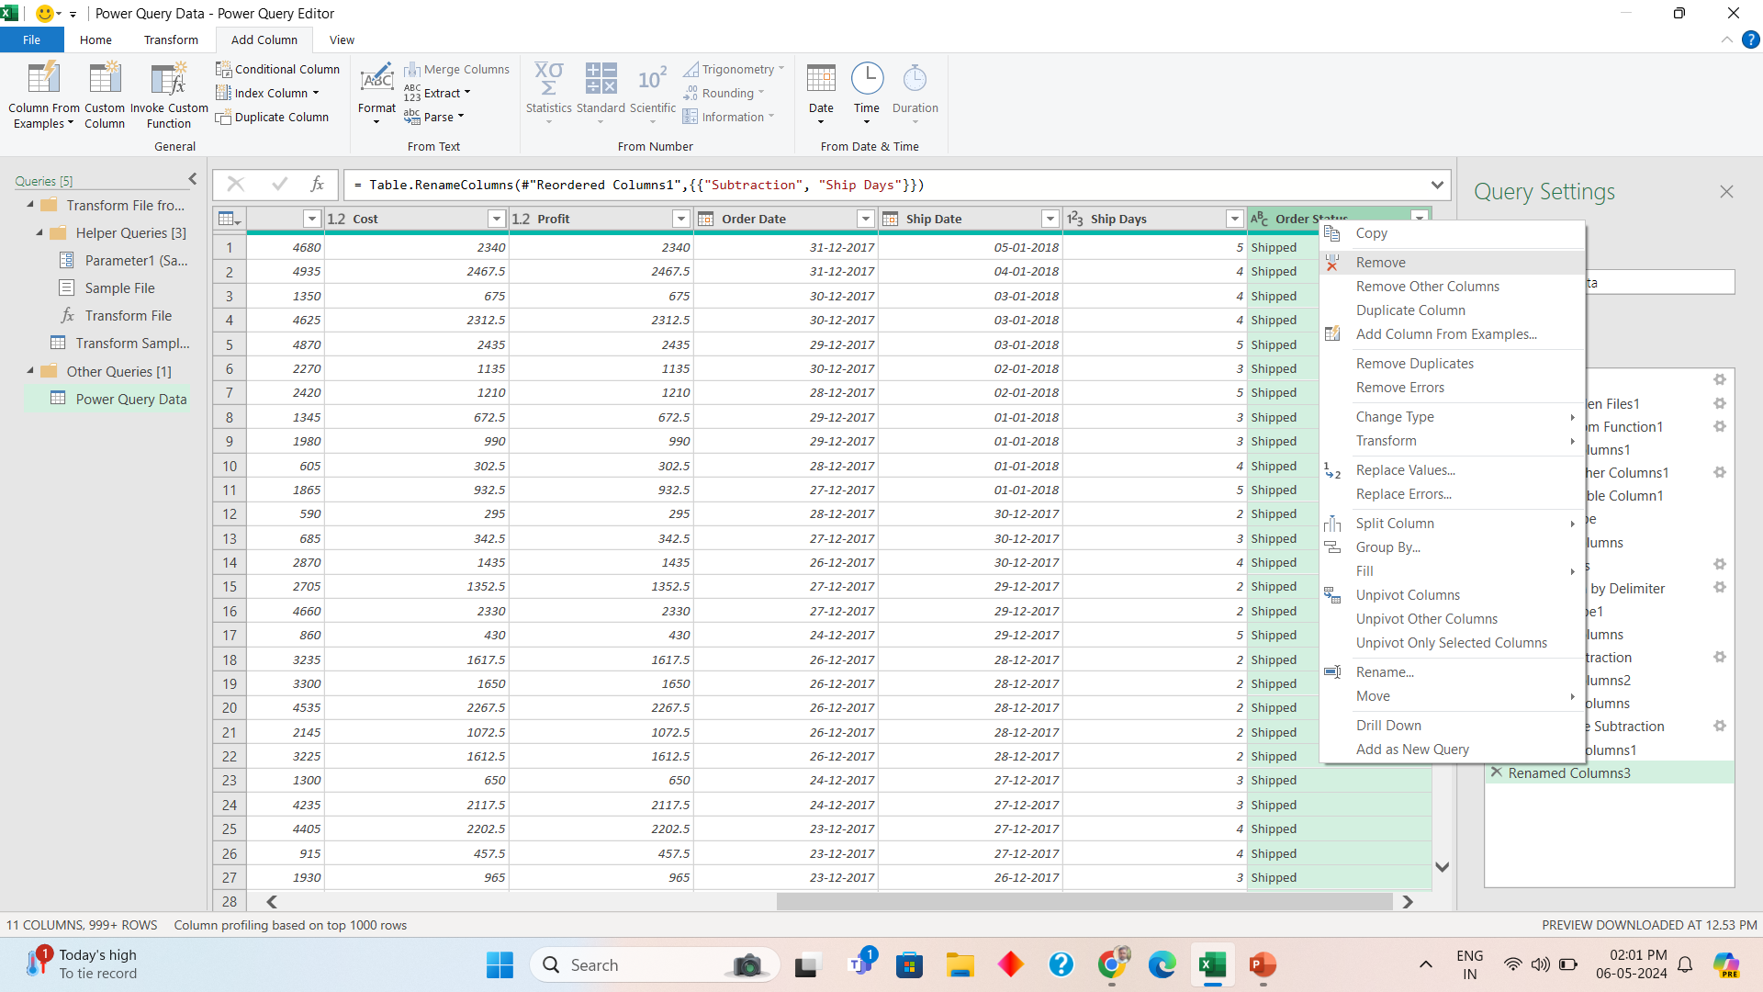
Undo steps in Power Query

Slide 15
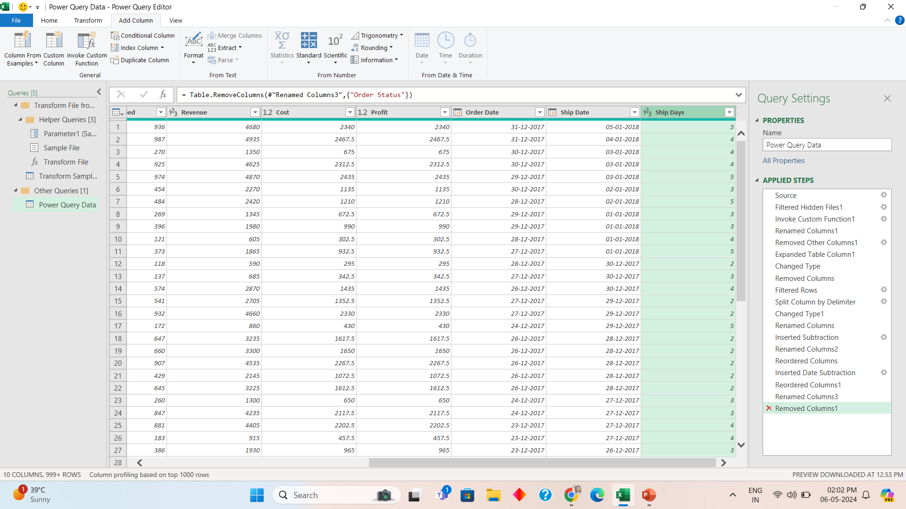
Undo continued

Slide 16
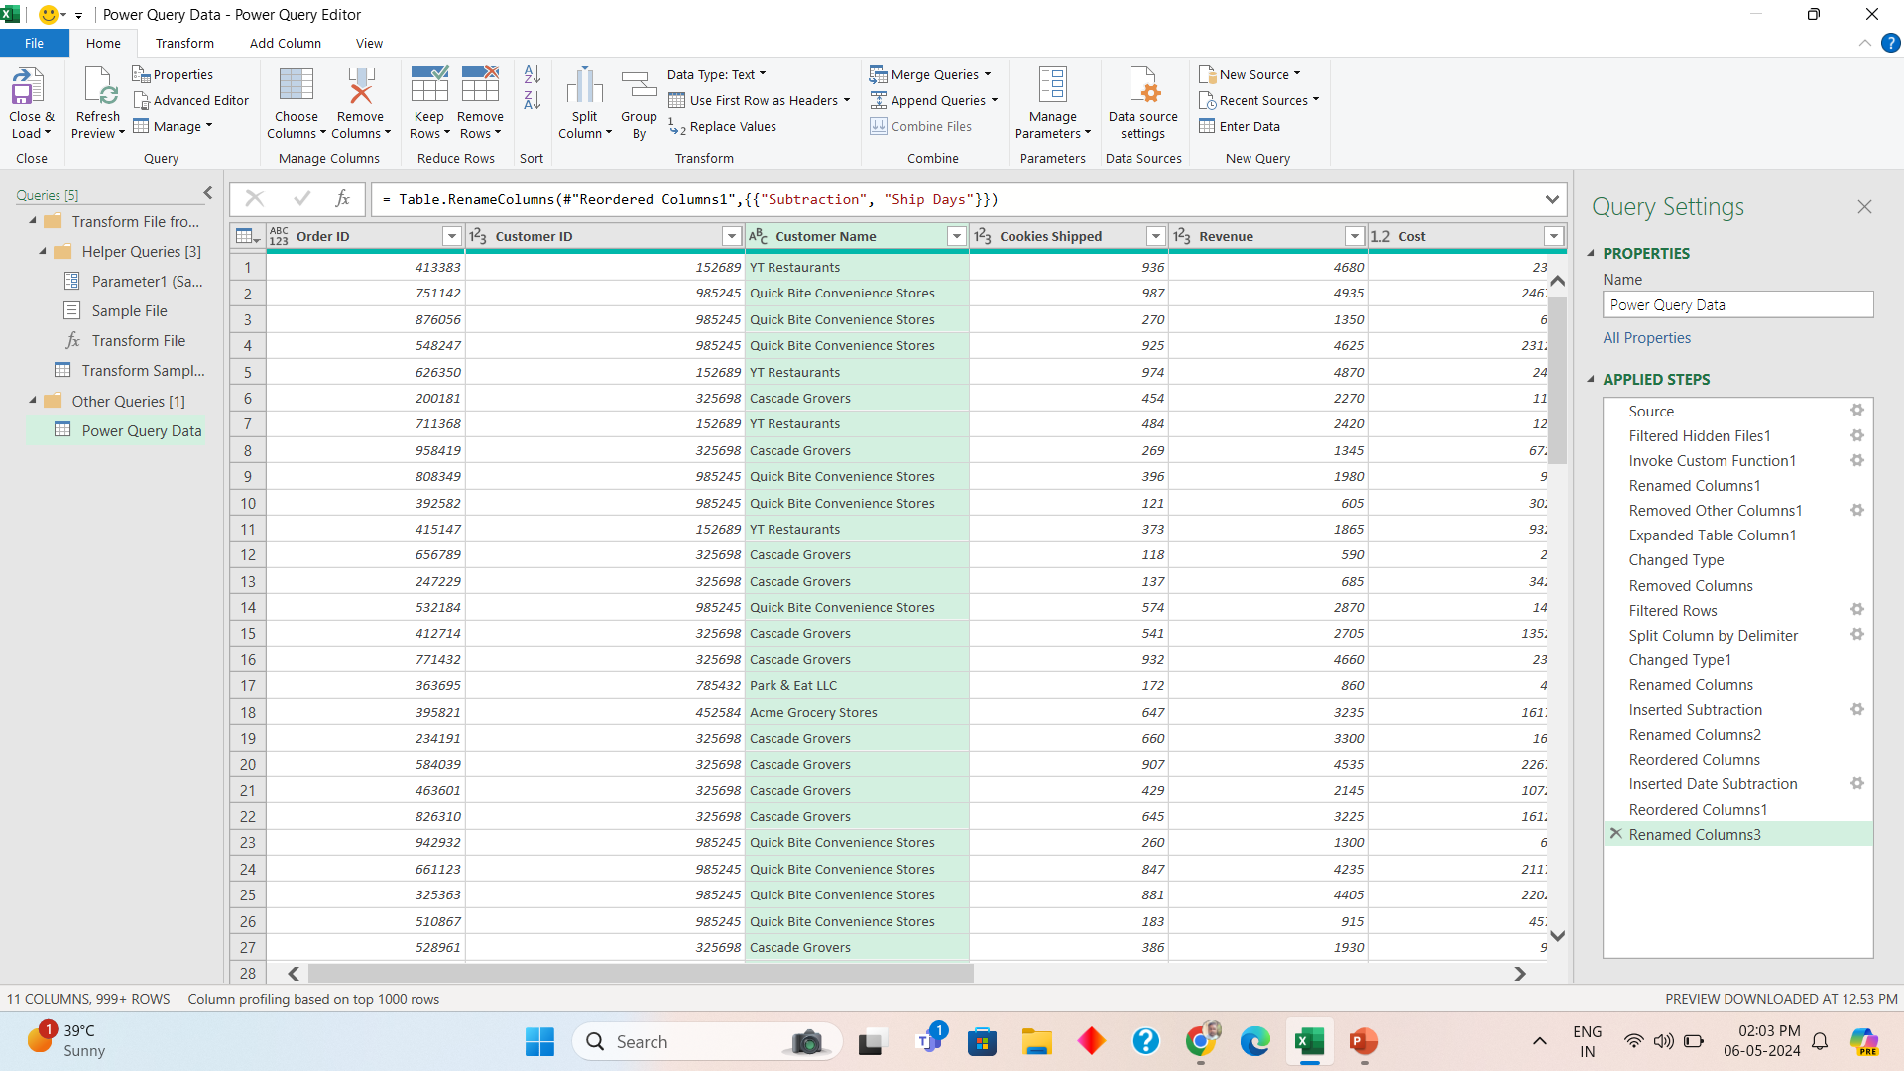
Save and Close Power Query

Slide 17
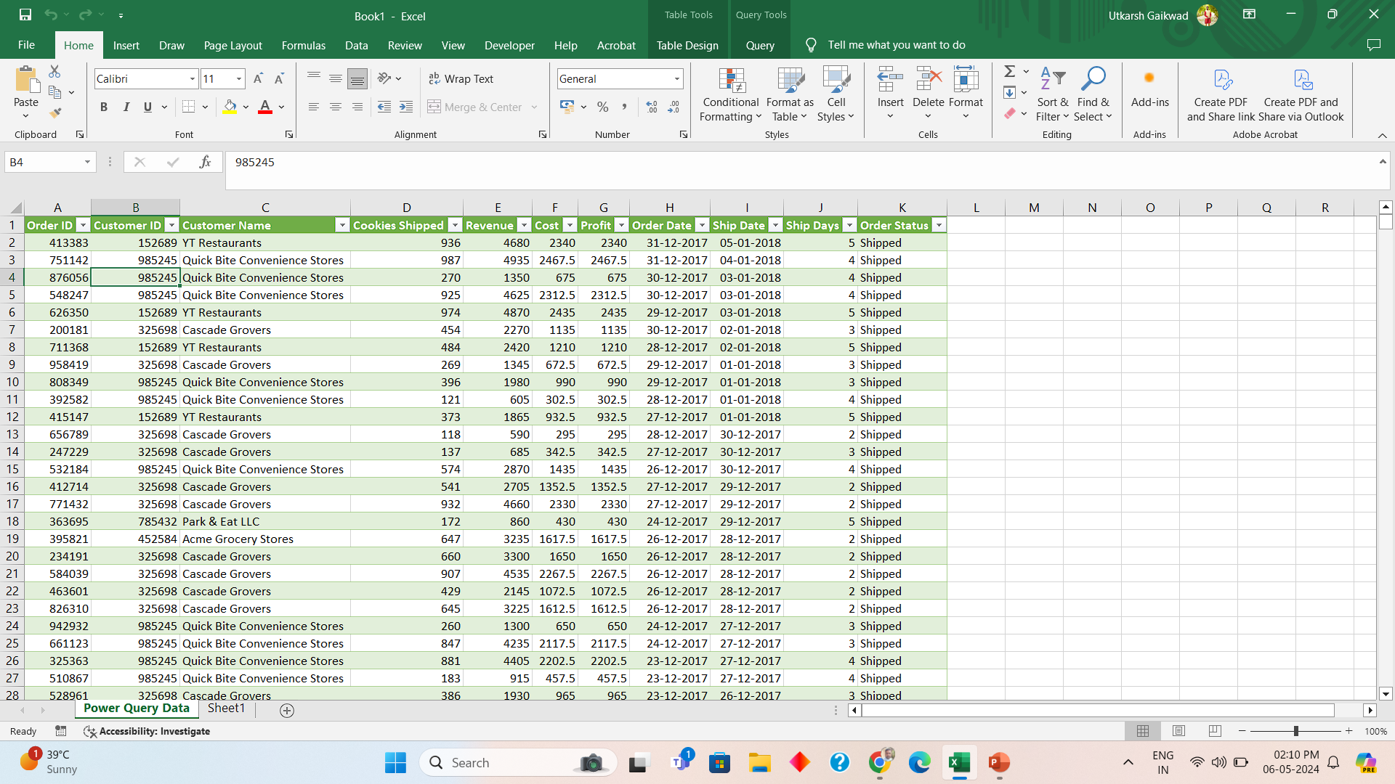
Done, Can apply pivot tables to analyze data further

Slide 18
Thank You
Varsha mhetre

